Slide 1
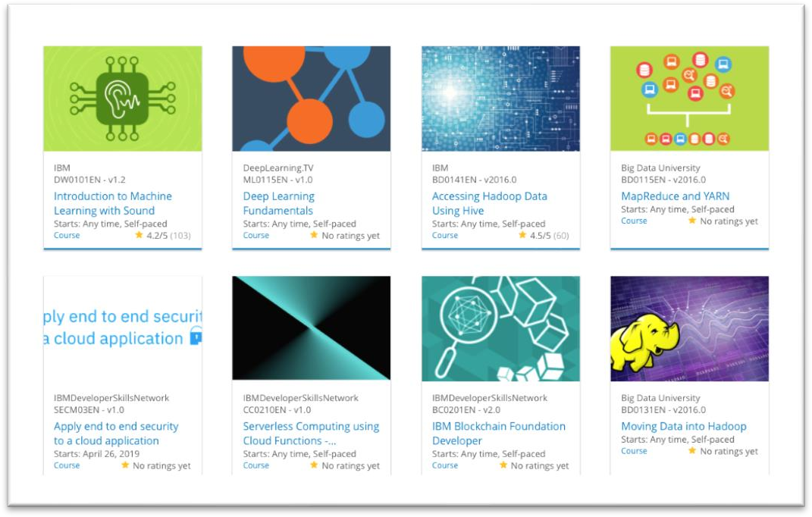
Build a Personalized Online Course Recommender System with Machine Learning
Angel Ventura Beltran

Slide 2

Outline
Introduction and Background
Exploratory Data Analysis
Content-based Recommender System using Unsupervised Learning
Collaborative-filtering based Recommender System using Supervised learning
Conclusion
Appendix
2

Slide 3
Introduction
A course recommendation system will help in:
Finding better courses
Finding courses that well suits each person’s interests
We aim to find the best courses to recommend to users based on their interests, their friend’s
interests, and the courses they are enrolled in.
Obstacles
We have many approaches
Each approach has different assumptions
3

Slide 4



Exploratory Data Analysis

Slide 5
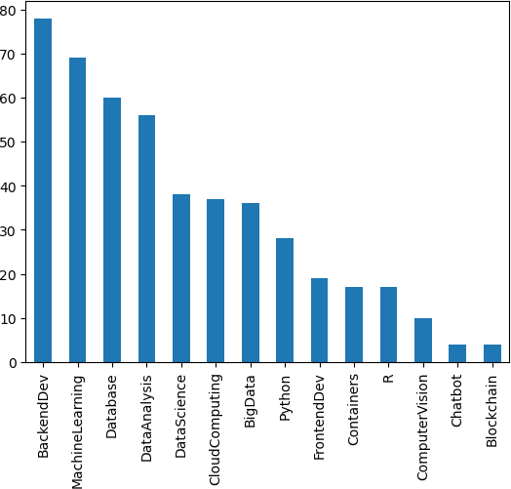
Course counts per genre

Slide 6
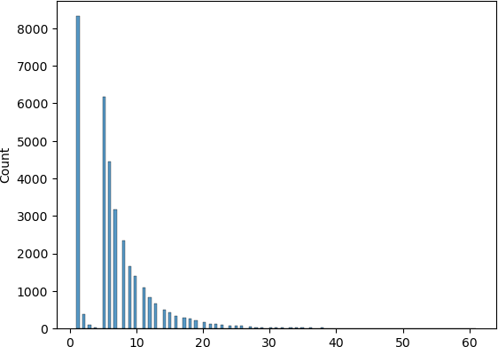
Course enrollment distribution

Slide 7

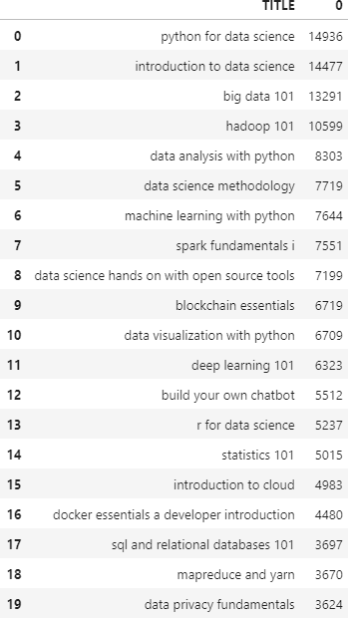
20 most popular courses

Slide 8
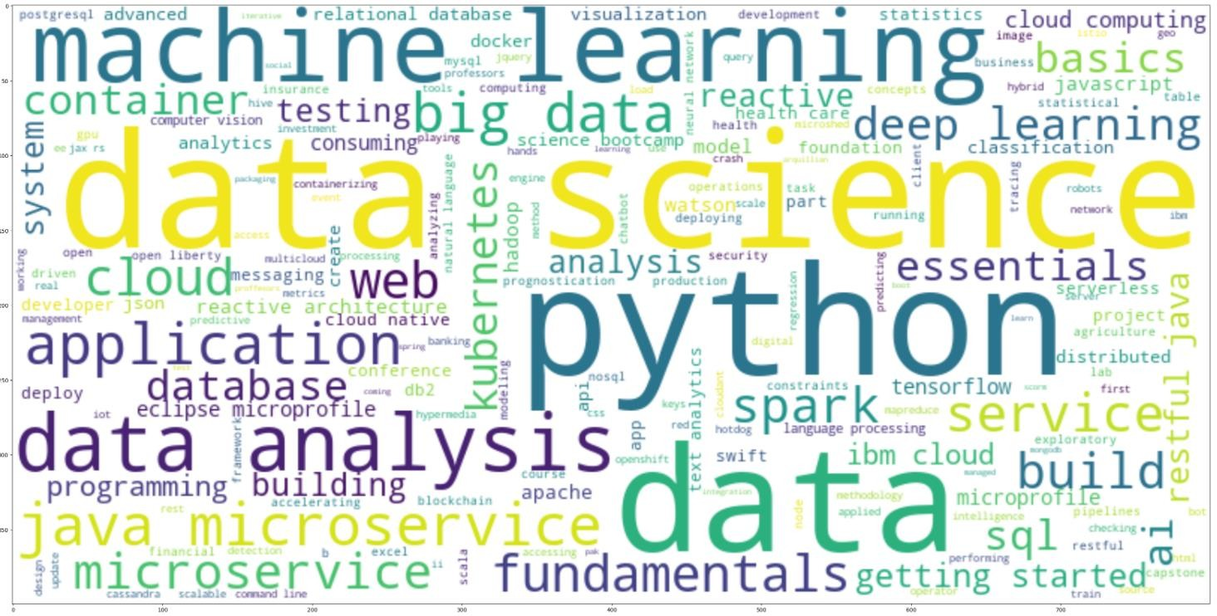
Word cloud of course titles

Slide 9
Content-based Recommender System using Unsupervised Learning
Cluster2
Cluster1

Slide 10
Flowchart of content-based recommender system using user profile and course genres
Course genres for unknown courses
User profile vector
dot product
For each dot product, Check if score>threshold
no
yes
Don’t recommend
course
Add course to
recommendation list

Slide 11
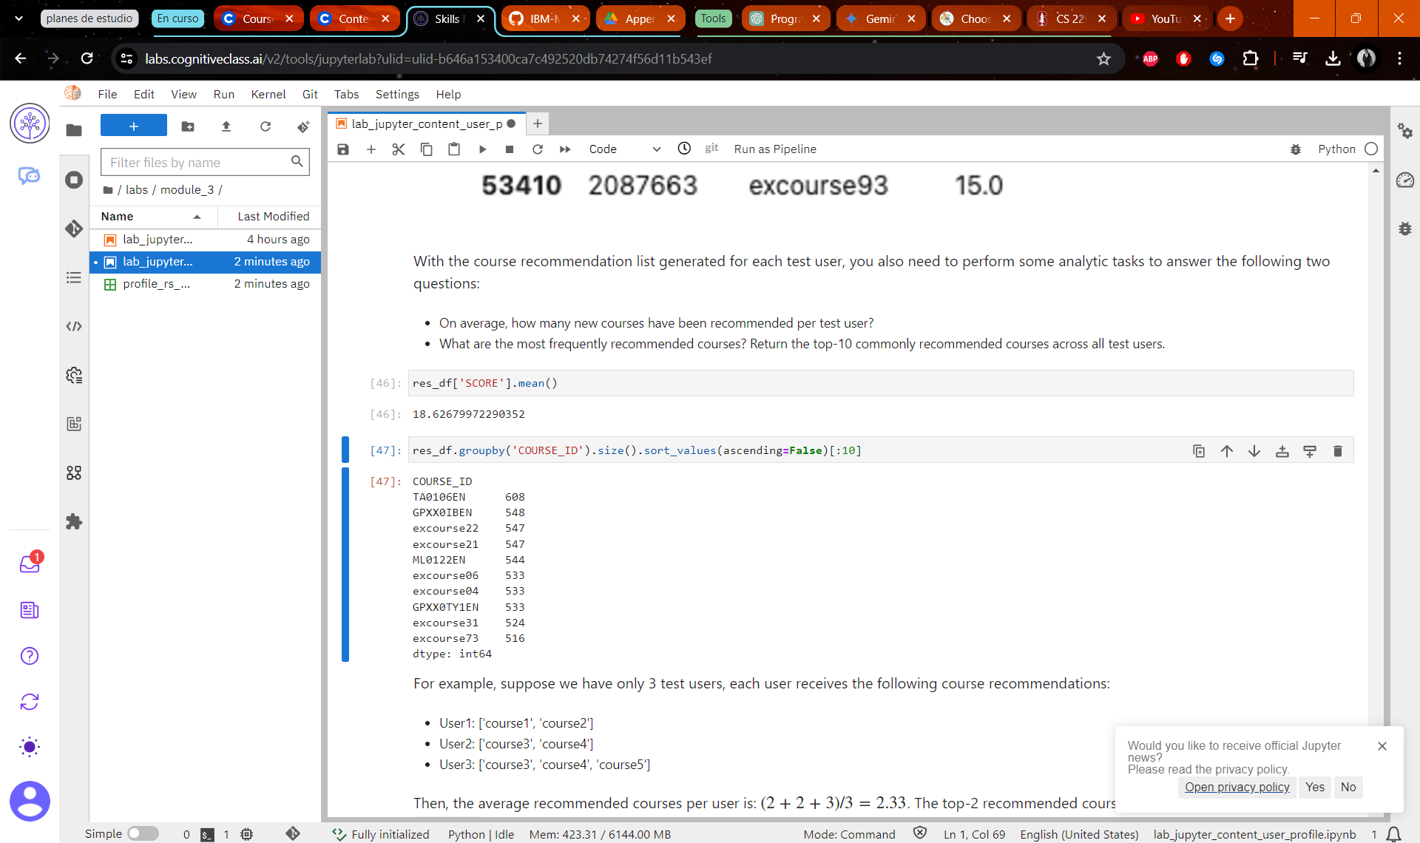
Evaluation results of user profile-based recommender system
Score_threshold = 10.0
On average, how many new/unseen courses have been recommended per user (in the test user dataset)
What are the most frequently recommended courses? Return the top- 10 commonly recommended courses across all users

Slide 12
Flowchart of content-based recommender system using course similarity
Enrolled course
Unselected course
Similarity matrix
Check if similarity> threshold
yes
Recommend Course
no
Don’t recommend
course

Slide 13
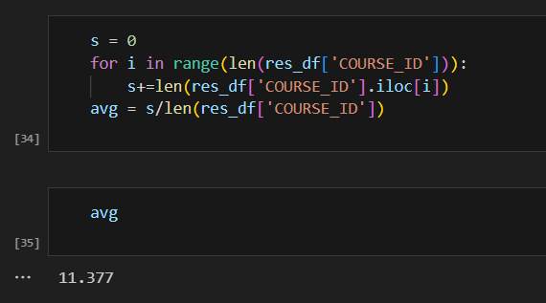
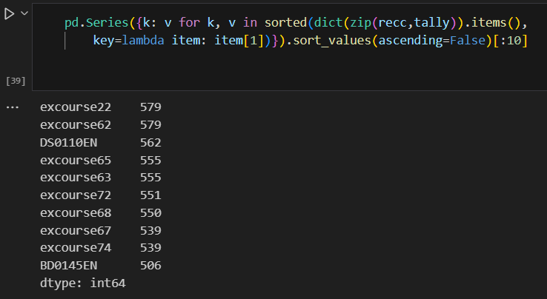
Evaluation results of course similarity based recommender system
Threshold = 0.6
On average, how many new/unseen courses have been recommended per user (in the test user dataset)
What are the most frequently recommended courses? Return the top- 10 commonly recommended courses

Slide 14
Flowchart of clustering-based recommender system
normalized user
profile features
Clustering model
For each user get cluster label
Grouped users
Find new/unseen courses
Get all courses belonging to cluster
Make
recommendations

Slide 15
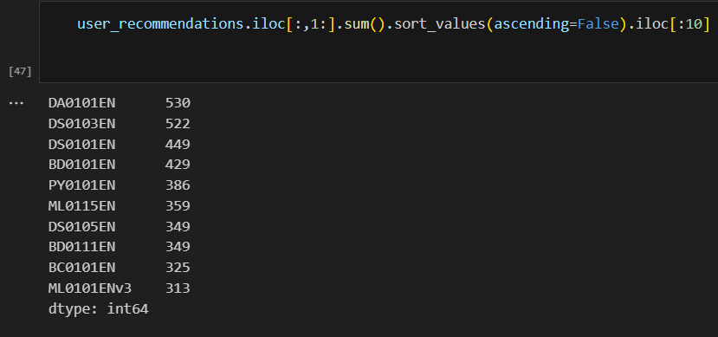
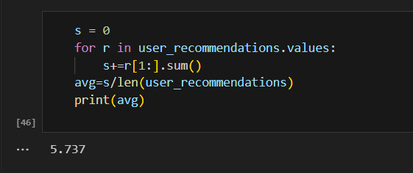
Evaluation results of clustering-based recommender system
Number of clusters = 20
On average, how many new/unseen courses have been recommended per user (in the test user dataset)
What are the most frequently recommended courses? Return the top- 10 commonly recommended courses

Slide 16
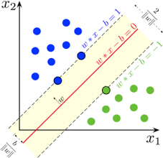
Collaborative-filtering Recommender System using Supervised Learning

Slide 17
Flowchart of KNN based recommender system
User interaction matrix
Similarity Matrix (cosine)
Train model Scikit surprise
Train test split
Make predictions

Slide 18
Flowchart of NMF based recommender system
User interaction matrix
Split into 2 dense
matrices U, I
Similarity by
matrix product
Use NMF
Make predictions

Slide 19
Flowchart of Neural Network Embedding based recommender system
User one hot encoded vector
Course one-hot encoded vector
Neural Network
Embedding
Score

Slide 20
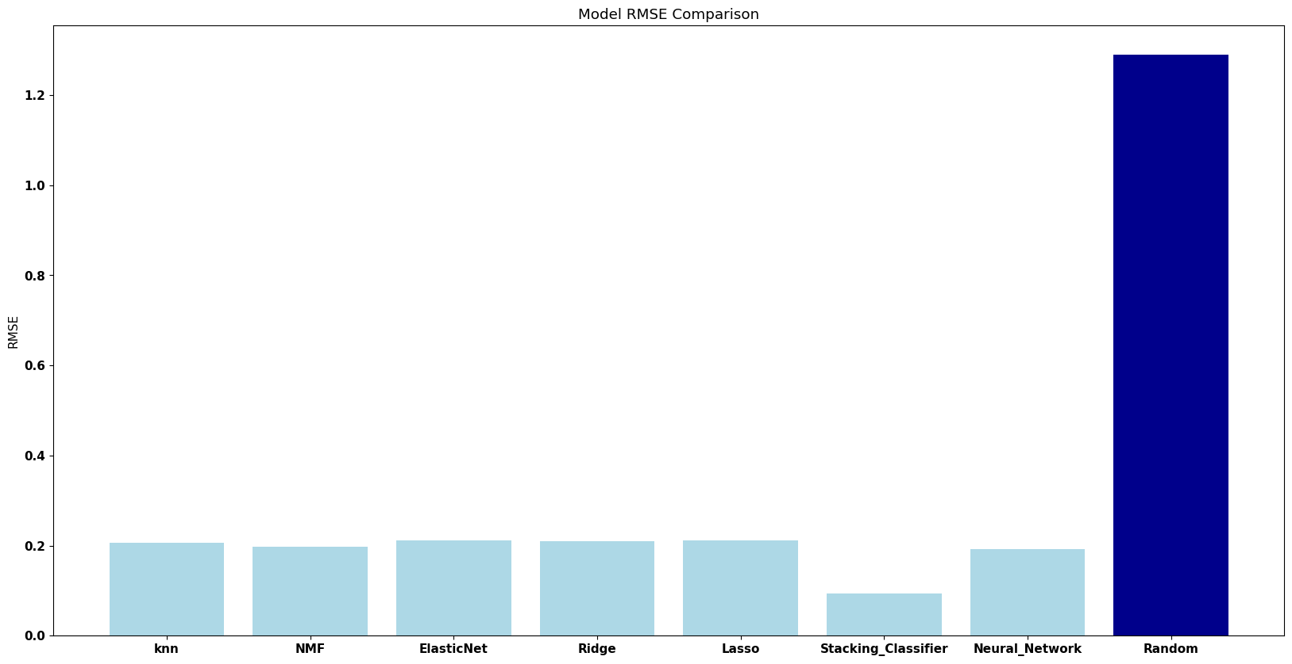
Compare the performance of collaborative- filtering models

Slide 21
Conclusions
Similar performance of models
User profile based has highest number of recommendations
Stacking Classifier has best performance
Similarity matrix’s high complexity
NMF as a solution
21

Slide 22
Appendix
All materials link https://drive.google.com/drive/folders/1OKcl56MRC4ShCSxeGA7x3dQPyf84i6rm?usp=sharing
22

